Slide 1

QTM 530 Computing I
Dr. Alejandro Sánchez Becerra

Slide 2
Agenda
Introductions
CLASS DETAILS
COMPUTING Environment

Slide 3

Main Instructor
TEACHING ASSISTANT
My name is Alejandro Sánchez Becerra
I did my Ph.D. in Economics at the University of Pennsylvania and completed a post-doc at New York University.
I’m originally from Bogotá, Colombia
My research focuses on causal inference, machine learning, and network analysis.
Sam Yin
Ph.D. Student in Biostatistics at Emory

Slide 4

My teaching philosophy
Interactive classes with hand-on learning.
Introduce key data science tools through real world examples
Encourage creative exploration.
One-on-one advising in office hours
Combination of theory and practice
Mentoring on communication

Slide 5
Grading
CLASS REQUIREMENTS
Homeworks (60% total):
6 homeworks
Self-directed projects 30%)
3 written deliverables
In-class workshop (10%)
Last day of class
HOMEWORK POLICY
- All assignments submitted past the deadline will be graded for half credit.
- We will automatically drop the worst homework assignment.
A | A- | B+ | B | B- | C+ | C | C- | D | F
93+ | 87-92 | 83-86 | 80-82 | 75-79 | 70-74 | 65-69 | 60-64 | 55-59 | 0-54

Slide 6
COURSE CONTENT
Programming essentials in Python
Process automation
Model deployment (introduction to key ML toolkits)
Database and production environment
Check Canvas for any adjustments to class schedule.

Slide 7
COURSE CONTENT
Key class announcements and assignments:
canvas.emory.edu
Class material will be regularly updated on Github (see instructions on Canvas)

Slide 8
Agenda
Introductions
CLASS DETAILS
COMPUTING Environment

Slide 9



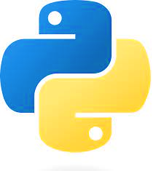
Our class in a nutshell …
+
Python
VS Code Interactive Development Environment (IDE)
Environment where the user writes the scripts
Script File
File with code in the Python programming language.
Instructions for the program to follow
Programming language we use to write the instructions
Virtual Environment

Slide 10
Installing Python using Anaconda
Follow the instructions Installing Python Using Anaconda from Canvas
We are using Anaconda virtual environments for this class
For now: Anaconda comes with a Python installation
Questions?

Slide 11
Installing VS code and connecting Anaconda
Follow the instructions Installing Visual Studio Code and Connecting it with Anaconda from Canvas
For now: know that “base” is the default Anaconda virtual environment that comes by default with the installation
The next step is to check if the connection between VS code and Anaconda worked → the Python: Select Interpreter option should include Python (‘base’)

Slide 12
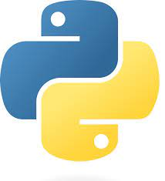


Lecture Notes
+
Python
VS Code
Github:
A file management system in the cloud (with desktop app)
Has version control
Great for collaborative programming

